Slide 1

Excelling… Steaming… Solutions…

Slide 2
FIELD OF OPERATION
Industrial Boilers
Thermal Energy Conservation Equipment
Small COGENERATION Systems

Slide 3
…. FIRST AND FOREMOST
Customer driven with USER SPECIFIC EXECUTION
…. COMMITTED TO EXCELLENCE
Equipment Performance, Quality, Timely Delivery and After-Sales-Service, THERMODYNE strives continuously to be FIRST among the Best.

Slide 4
… ANY FUEL, ANY STEAM PARAMETERS
FUEL
Fossil
Coal, Oil, Gas, Low Heat Gases
Renewable
Bagasse, Rice Husk, Mustard/Soya Husk, Palm Fibre and Shell, Wood Waste, Palm Empty Fruit Bunch, Other Biomass Fuels, Biogas.
COMBUSTION SYSTEM
Travelling Grate
Reciprocating Grate
Dumping Grate
Fixed Grate
Fluidized Bed Combustor
Oil / Gas Burners
Distillery Spent Wash Burners
PARAMETERS
1 to 200 TPH
7 kg/sq.cm(g) to
125 kg/sq.cm(g)
Dry Saturated or
Superheated
Specialty
Refuse Derived Fuel (RDF)Spent Wash (Distillery)Poultry Litter
CONFIGURATION
Bi-Drum - Water Tube
Single Drum – Water Tube
Packaged – Smoke Tube
Compo type

Slide 5
ONE STOP SOLUTION
Travelling Grate Fired
Dump Grate Fired
Reciprocating Grate Fired
Fixed Grate Fired
Bubbling Fluidised Bed
Oil /Gas Fired
Heat Recovery
Water Tube – Fire Tube - Compo

Slide 6
Industries We Serve
Sugar
Paper
Co-Gen
Independent Power
Captive Power
Distillery
Textile Processing
Rubber
Food & Pharma
Sponge Iron
Chemical / Petrochemical
Palm Oil
Other Process Heat Applications

Slide 7
HEAT RECOVERY BOILERS
Gas Turbine Exhaust
Diesel Engine Exhaust
Kiln Exhaust

Slide 8
The Product Range
COGEN SYSTEMS
INDUSTRIAL BOILERS
HEAT RECOVERY EQUIPMENT
Up to 200 TPH capacity, 125 atmospheres pressure
Bagasse / Husk / Biomass Fired Boilers
Coal / Oil / Gas Fired Boilers
Heat Recovery Boilers
RDF (MSW) Fired Boilers
Spent Wash (Distillery) Boilers
Up to 50 TPH Steam and 5000 KW Power
Air Repeaters
Economisers
Feed Water Heaters
STEAM GENERATOR PRESSURE PARTS
Superheaters
Economisers
Boiler Bank and Water Walls
Piping
Services
Turnkey Services – Concept to Commissioning
Revamp / Upgrade of Industrial Boilers
Engineering / Technology Transfer – Overseas
Trouble Shooting – Industrial Boilers

Slide 9
THE CUTTING EDGE TECHNOLOGY
THERMODYNE Technologies is uniquely positioned Indian Company to have provided Boiler Technology to leading overseas Boiler Manufacturers.
PRINCIPALS to Petra Boilers, Malaysia (1992 – 2007)
THERMODYNE Technologies has COMPLETE range of Modern State-of-the-art Technology for different types and configurations of Industrial Boilers, to offer ONE-STOP solution to meet the end user’s Steam requirement.
For Palm Waste (Biomass) Water Tube Boilers
PRINCIPALS to Advance Boilers, Malaysia (2003 – 2006)
For Palm Waste (Biomass) Water Tube Boilers
LICENSOR to English Boiler & Tube, Virginia, USA (2003 – 2008)
For Oil / Gas Fire Tube Boilers

Slide 10
THE CUTTING EDGE TECHNOLOGY
Thermodyne Technologies with its leadership in Boiler Technology, have secured / executed several First-of-its-kind jobs, establishing their position as “Pioneer –Then, Leaders now”
Thermodyne Technologies is the FIRST Indian Boiler Company to Export Palm Oil Mill Boiler to Indonesia,
25 TPH Capacity (1999 – 2000)
Thermodyne Technologies is the FIRST to introduce Dumping Grate Combustion System for Bagasse at
87/kg/sq.cm(g) Pressure Boiler (110 TPH / 87 atg / 510 Deg.C at Simbhaoli Sugars, Uttar Pradesh) (2007).
Thermodyne Technologies is the FIRST and ONLY Indian Boiler Company to couple Waste Heat Boiler to
Externally Fired Envirocycler Biomass Combustor (Installation in Malaysia) (2009).
Pulverised Fuel Firing System for Sponge Iron India, to augment Waste Heat Boiler based 5 MW Captive Power Plant. This is the FIRST and ONLY of its kind in India.

Slide 11
THE CUTTING EDGE TECHNOLOGY
5 TPH / 37 kg/sq.cm with integral Superheater Smoke Tube Boiler for Department of Atomic Energy. This Boiler is unique with HIGHEST possible pressure for a smoke tube boiler of this size and with integral superheater.
140 TPH / 87 kg/sq.cm(g), 520 Deg.C Bagasse-cum-Coal Fired Boiler for Shree Renuka Sugars , Karnataka.
Capacity upgrade of existing Boilers, 40 TPH to 48 TPH for Rana Sugars, 32 TPH to 40 TPH for Oswal Sugars in Punjab, 20 TPH to 27 TPH for Sahakari Khand Udyog, Gujarat.
Capacity Upgrade / Revamp
Capacity upgrade 20% to 25%
Additional core firing Retrofits
Fuel conversion – Bagasse to Coal, Coal to Mustard Husk
Mustard Husk Fired Boiler with longest mean time between cleaning.

Slide 12
THE CUTTING EDGE TECHNOLOGY
30 TPH, Multi Fuel Fired Boiler Design and Engineering and Supply of Grate for
Advance Boilers, Malaysia to fire Empty Fruit Bunch, Rice Husk and Log Wood.
This is unique application demanding use of 2 Meter long Log Wood and continuous
Ash discharge, combined with capability of firing other Biomass Fuels (2002).
Spent Wash (Distillery) Fired Boiler, Sunil Hitech, Maharashtra with distinctive design and construction features.
Refuse Derived Fuel (Municipal Solid Waste), Srinivasa Gayithri, Karnataka with distinctive design features.
All Membrane Water Tube Waste Heat Boilers, utilizing Refinery Incinerator Gas, for Indian Oil Corporation through Callidus Technologies.
100% Cashew Deoiled Shell Fired Boiler for Rajkumar Impex.
First 18 TPH at 65 kg/sq.cm(g), 485 Deg.C Husk Fired FBC Boiler for Gulshan Sugars and Chemicals (2002).

Slide 13
THERMODYNE BOILERS ARE CHARACTERIZED BY…
Membrane Water Wall (Water Tube & Compo Boilers)
Three Pass Full Wet Back (Smoke Tube Boiler)
Low Flue gas outlet temperature
Low Excess Air
Unsurpassed Boiler Efficiency
Well proportioned combustion regime
Optimised Heat Transfer Surfaces
O&M focused layouts
Extended equipment life span
Low maintenance and high reliability
… TO GIVE LOWEST STEAM COST

Slide 14
EXPERIENCE PROFILE KEY PERSONS
PREVIOUS CAREER EXPOSURE
12-15 years with Bharat Heavy Electricals Ltd., Tirchy a Premier National Organisation in High Pressure Boilers
Immense familiarity up to 200 MW Utility Boilers of capacity 700 TPH, Pressure 138 kg/sq.cm(g) , Temperature 540 Deg.C
Industrial Boilers up to 200 TPH, Pressure 105 kg/sq.cm(g).

Slide 15
EXPERIENCE PROFILE KEY PERSONS
TRAINING EXPOSURE
Exposure to know-how and know-why at Internationally Renowned Organisations.
Combustion Engineering – USA
International Institute of Welding – Czech

Slide 16
EXPERIENCE PROFILE
The experience and expertise through varied practical applications and through participation in national and international projects.
The engineering skills developed in designing a very broad range of steam generating systems and other heat transfer systems like Economizers, Superheaters, etc. and Pressure Vessels, and Heat Exchangers.
The familiarity of the requirements of international and national codes like ASME, BS, DIN, TEMA, IBR, etc.
The capability developed to trouble shoot, analyse and resolve field problems.

Slide 17
EXPERIENCE PROFILE
The specific kills developed in high technology fabrication processes such as High Pressure Welding, Metal Forming, Heat Treatment, Metallurgy and Machining.
The in-depth knowledge in manufacturing services in all facets of Planning, Processing, Procurement, Quality Control, etc.
The understanding of the requirements of international Inspection Agencies such as Lloyds, Preece Cardew & Rider, Bureau Veritas.

Slide 18
QUALITY
QUALITY POLICY
To operate on the principle of “Do Right Things Right” permeating through all relevant disciplines of Engineering, Manufacture and Installation.
QUALITY ASSURANCE
System
CERTIFICATION
Indian Boiler Regulations (IBR)
ISO 14001 : 2015
To provide on-time and appropriate service to customer
To meet maximally the End User expectations on Product Performance and Reliability.
Inspection Standards & Procedures, Design Document & Revision
Control, Procurement Control, Manufacturing Process Control,
Gauges & Instruments Calibration, History Card Maintenance,
Failure Analysis.
ASME “S” Stamp Authorization
ISO 18001 : 2007
QUALITY CONTROL
Inspection
Receipt: In-Process Stage, Sub-Assy.
Stage :Final Assembly and Pre-Despatch.
Testing
In-house
Dye-Penetrant, Magnetic Particle,
Radiography, Ultrasonic, Hydrostatic
Outsourcing
Mechanical, Chemical, Spectral
Third Party Inspection
Jobs specific under third party inspection by reputed Agencies like ABS, Bureau Veritas, Gernamischer Lloyd, IIQA, Lloyd’s Register Asia, SGS.

Slide 19
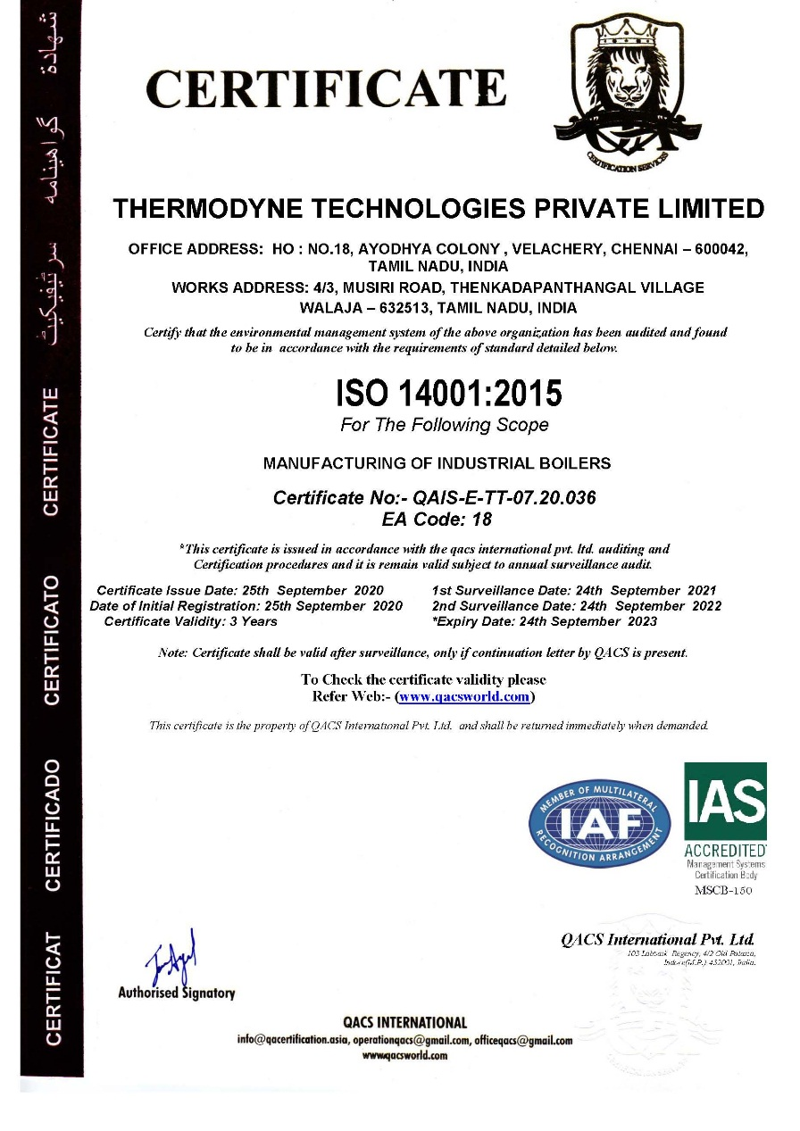
QUALITY
CERTIFICATION –
ISO 14001 :2015

Slide 20
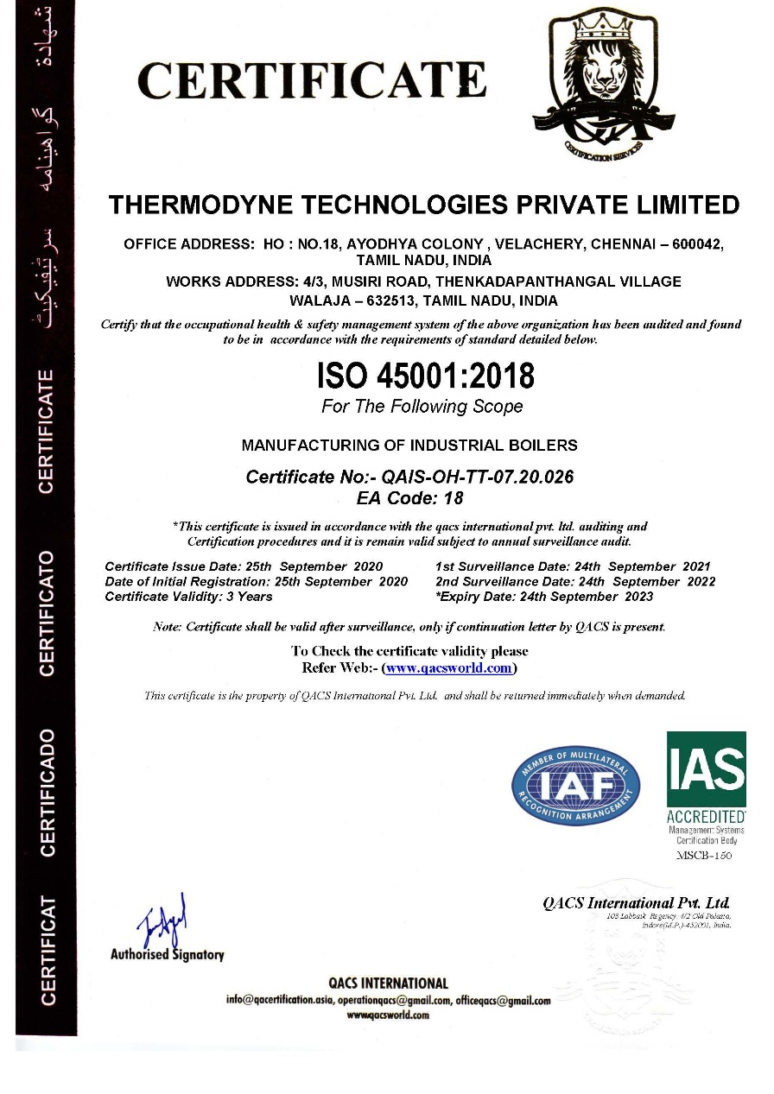
QUALITY
CERTIFICATION –
ISO 45001:2018

Slide 21
MANUFACTURING CAPABILITY
Location
Ranipet & Musiri, Walaja (Off Chennai-Bengaluru Expressway) Tamilnadu
Land Area
15 Acres
Code of Practices
IBR, ISO R 831, ASME Section I, IV, VIII, BS 2790, BS 1113, BS 806, BS 5500, ANSI B31.1, AWS
Materials
Carbon Steel, Low Alloy Steel, Stainless Steel

Slide 22
MANUFACTURING CAPABILITY
Facilities
In-house
Gas Cutting : 100 mm
Tube Bending : 76 dia x 4 mm
Drilling : 76 mm
Welding : MMA, TIG, SAW, CO₂
Heat Treatment: 1.5 metre x 2 metres
Machining : Light turning, Chamfering
Outsourcing Tie-up
Plate Rolling : High Thickness
Drilling : High Diameter
Heat Treatment Large Size
Machining : Heavy Size
Handling
Plate Rolling : 20 mm
Tube expansion: Various ranges
Gantry Crane : 20 MT
Mobile Crane : 40 MT
Rotators : 80 MT
Power Connection
900 HP (Total)

Slide 23
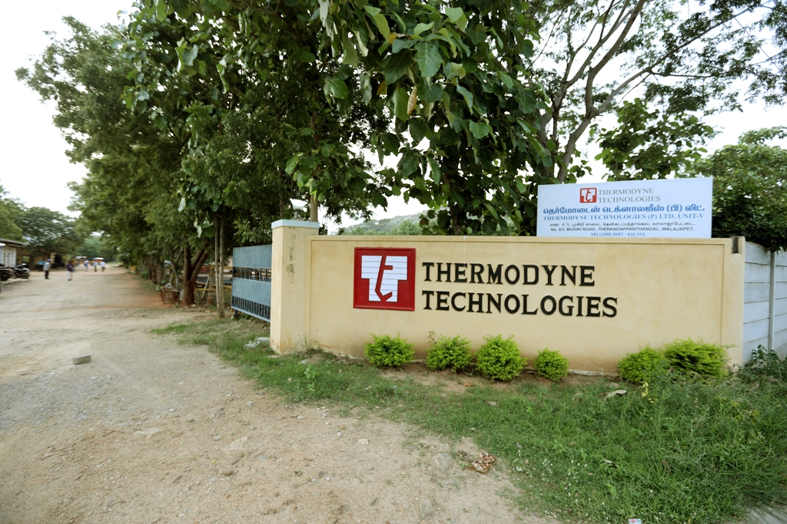
Location
Main Plant 12 Acre Plot
Musiri ( Off Chennai – Bengaluru Expressway )

Slide 24
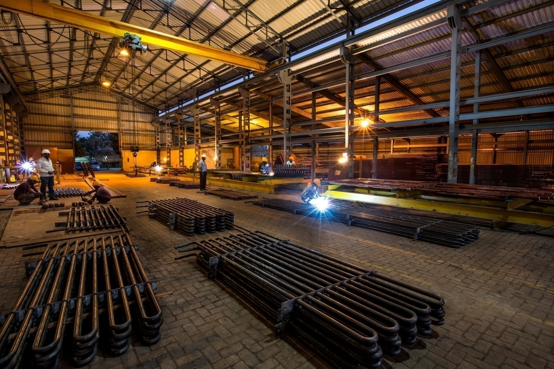
Facilities
Main Plant - Tubular Shop

Slide 25
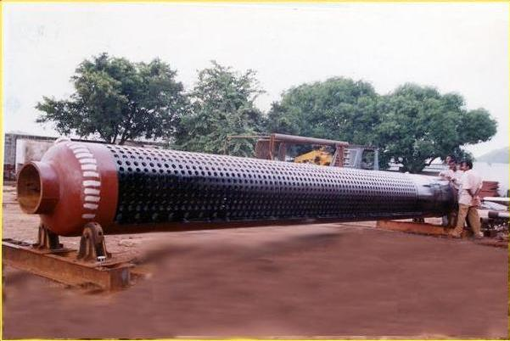
Boiler Components
FACTORY
Water Drum D- Type Boiler
Predespatch

Slide 26
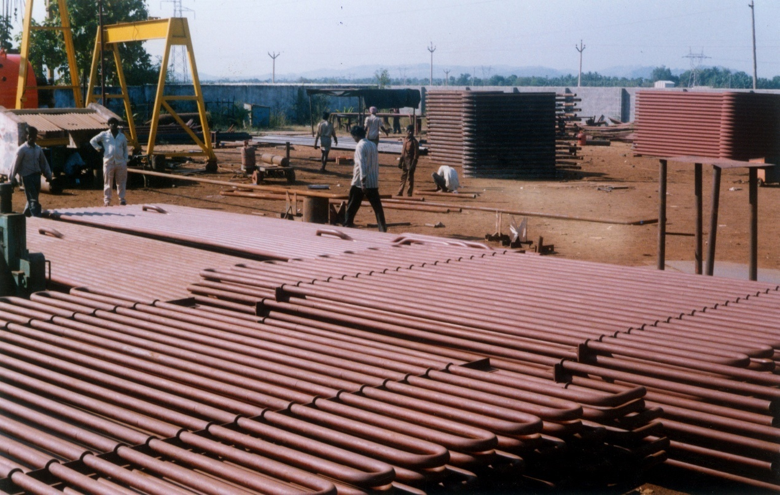
Boiler Components
FACTORY
Economiser Coils
Assembly completion

Slide 27
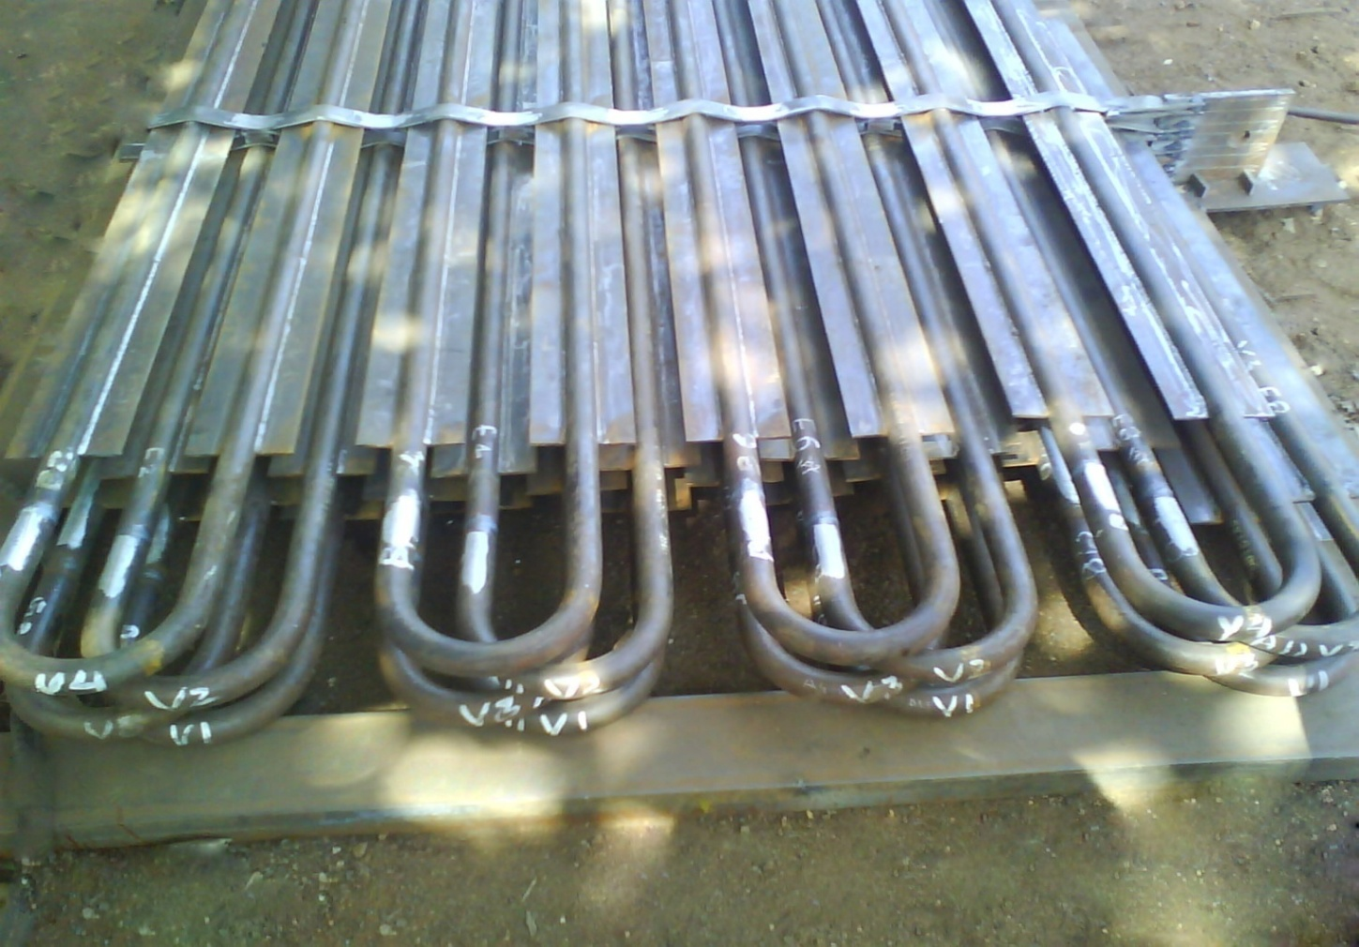
Boiler Components
FACTORY
Flat fin Economiser
Assembly completion

Slide 28
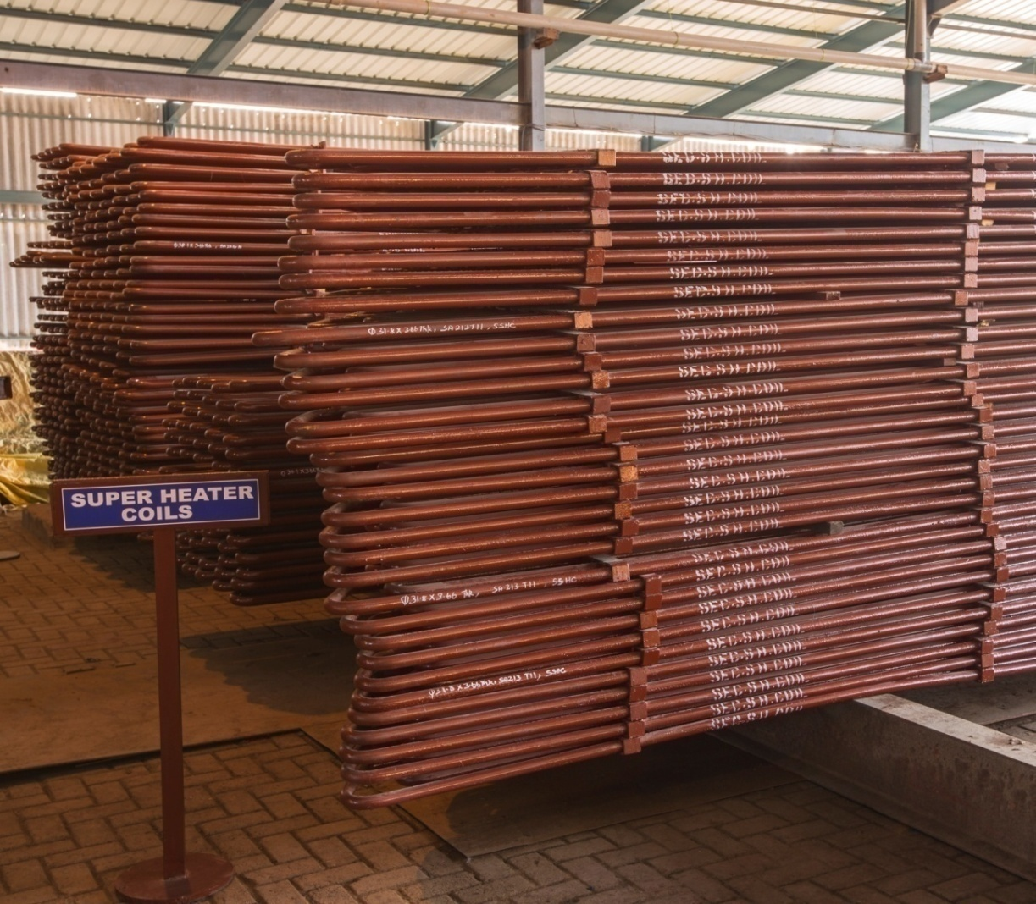
Boiler Components
FACTORY
Superheater Coils
Assembly completion

Slide 29
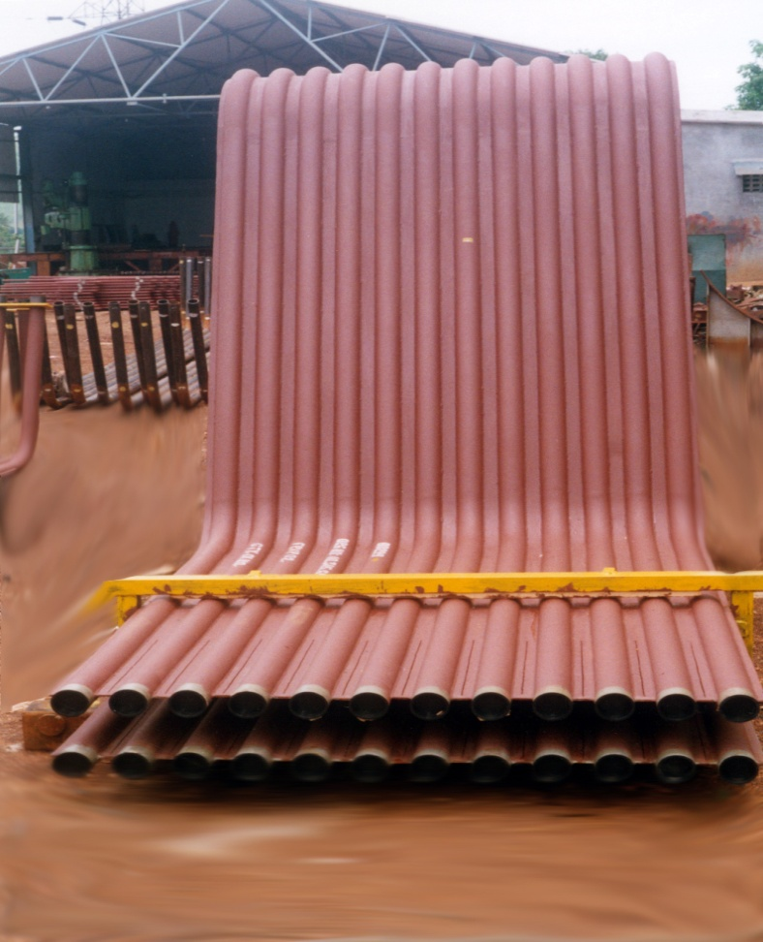
Boiler Components
FACTORY
Water Wall Nose
Predespatch

Slide 30
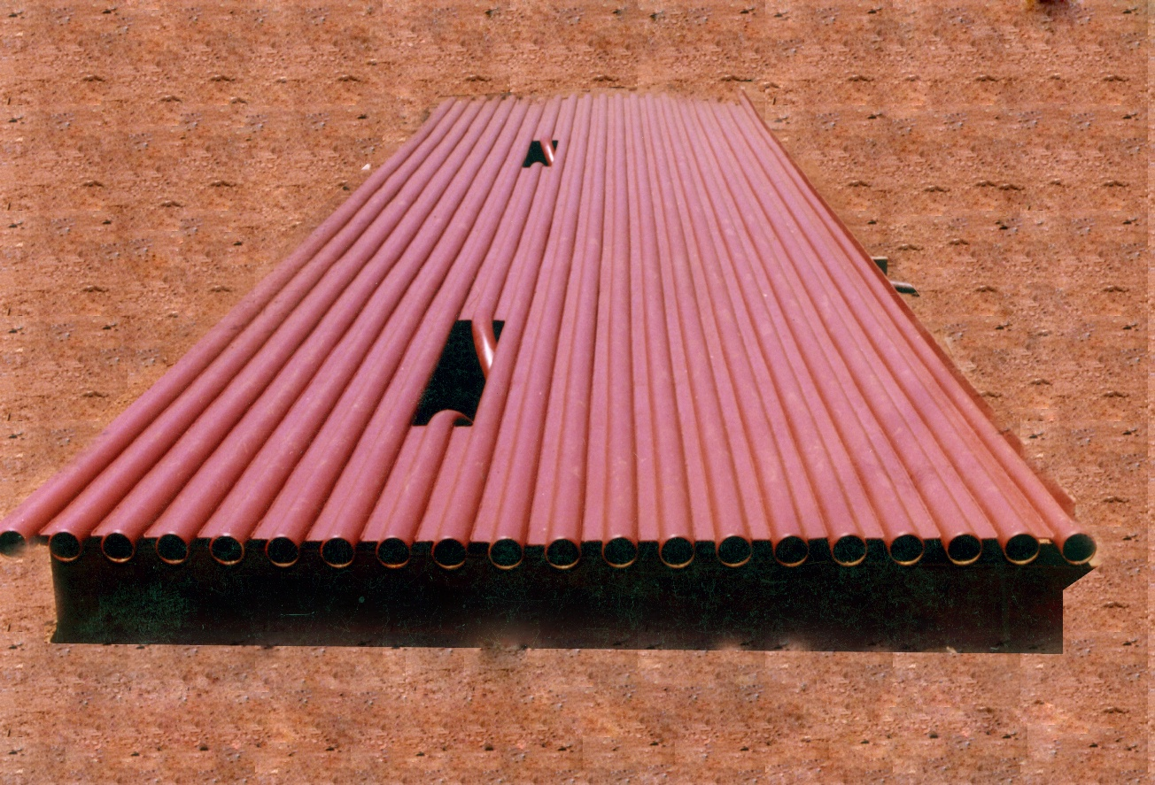
Boiler Components
FACTORY
Membrane Water Wall
Assembly completion

Slide 31
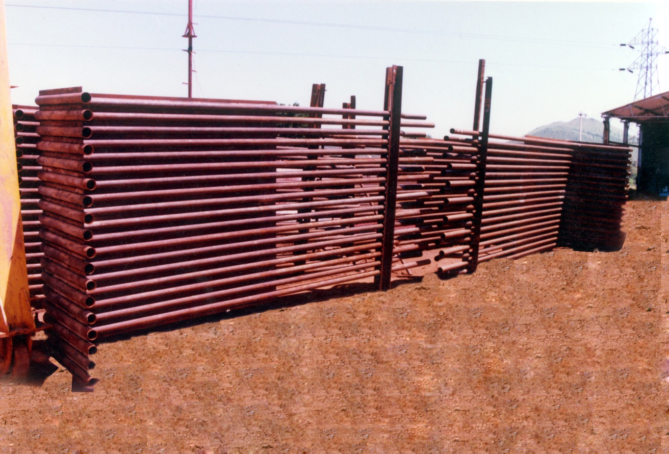
Boiler Components
FACTORY
Tubular Part
Predespatch

Slide 32
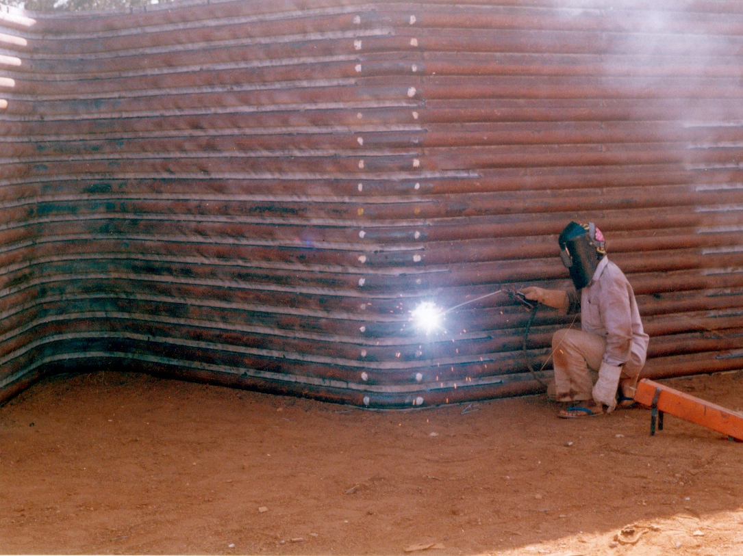
Boiler Components
FACTORY
Welding of Water Wall Nose
Work – In – Progress

Slide 33
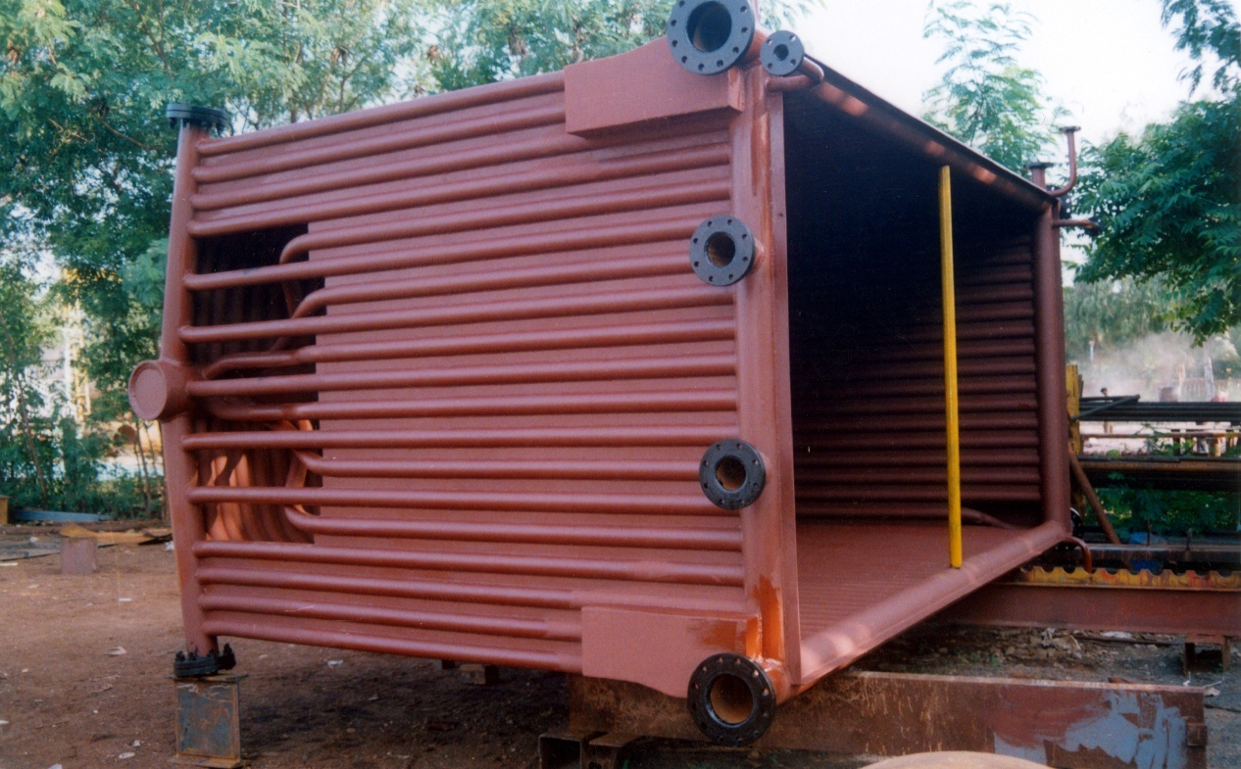
Boiler Components
FACTORY
Radiant Chamber – Compo Boiler
Predespatch

Slide 34
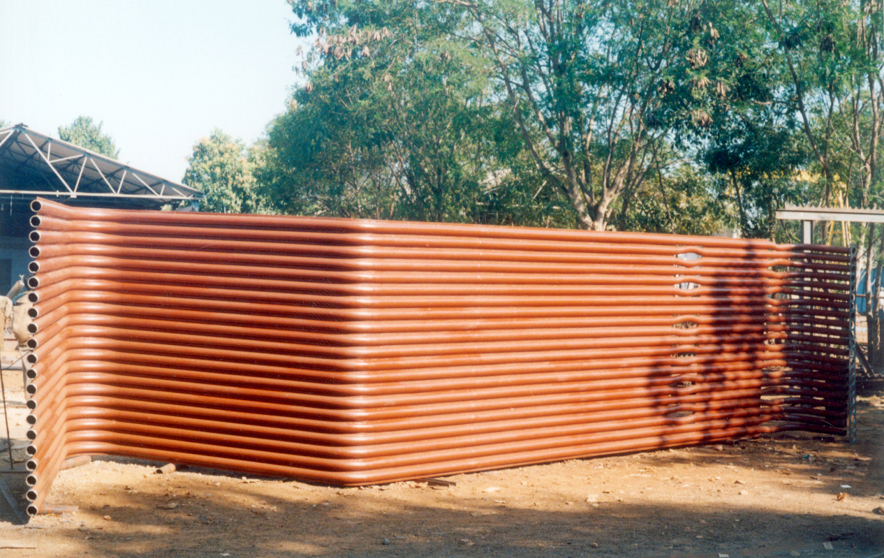
Boiler Components
FACTORY
Water Wall – Nose Panel
Assembly Completion

Slide 35
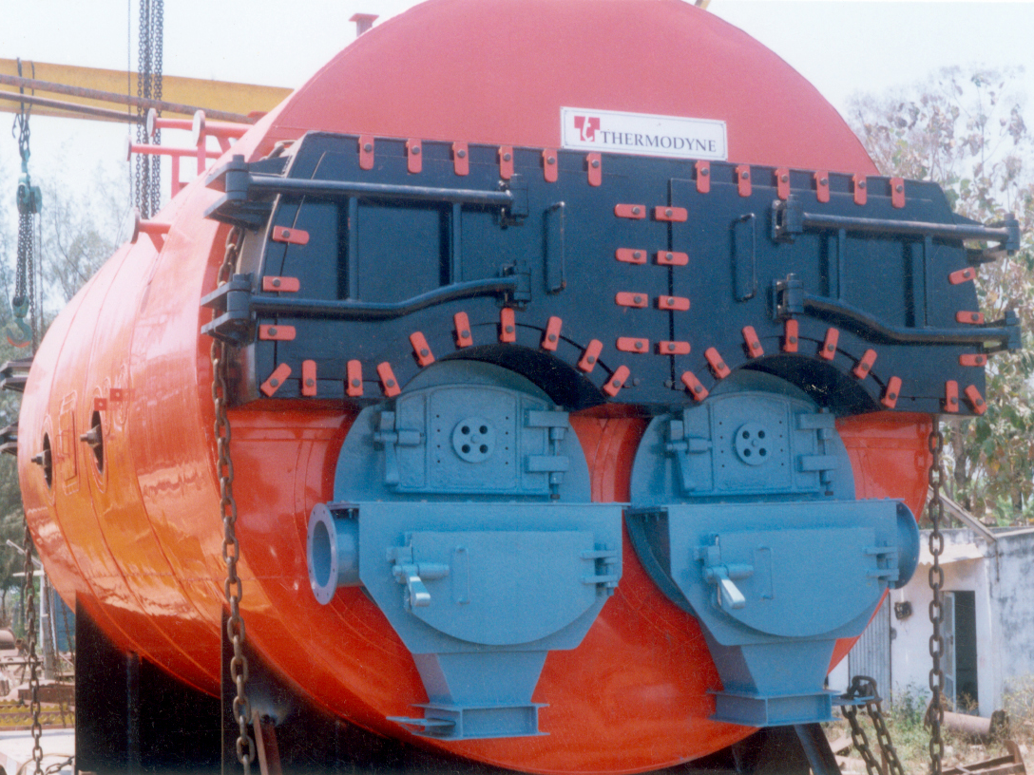
FACTORY
Solid Fuel Fired Boiler
Twin Flue – Fire Tube
Predespatch

Slide 36
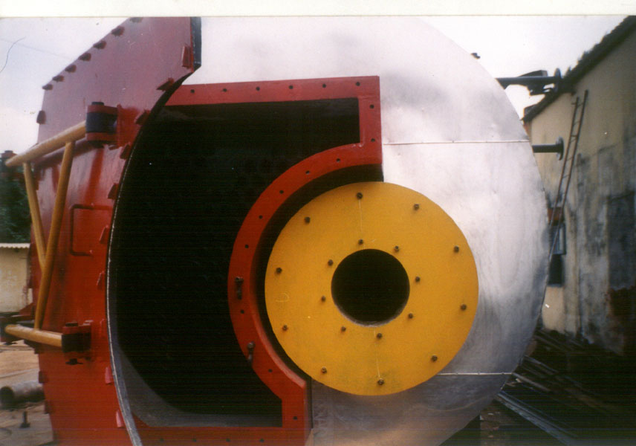
Boiler Components
FACTORY
Oil Fired Fire Tube Boiler
Front Smoke Box – Offset Flue

Slide 37
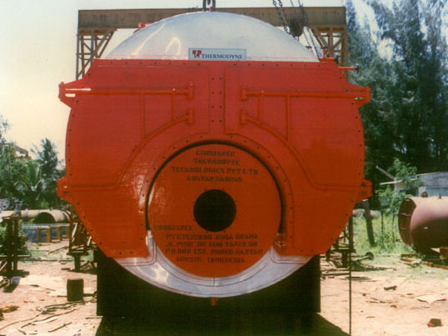
FACTORY
Oil / Gas Fired Fire Tube Boiler
Central Flue

Slide 38
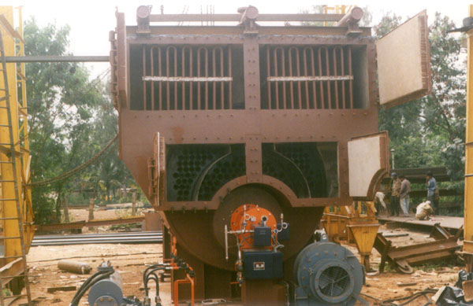
FACTORY
Fire Tube Boiler / High Pressure (35 bar)
with Integral Super heater

Slide 39
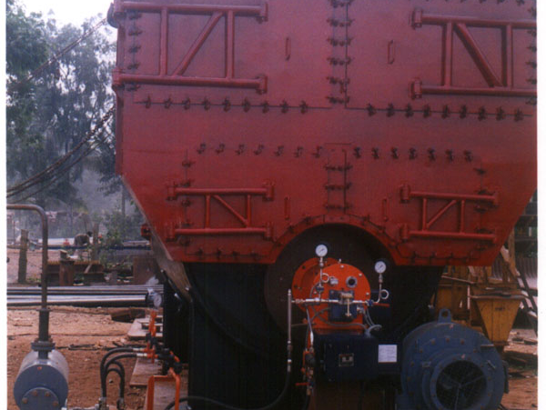
FACTORY
Fire Tube Boiler / High Pressure /35 barg w / Super heater
Predespatch

Slide 40
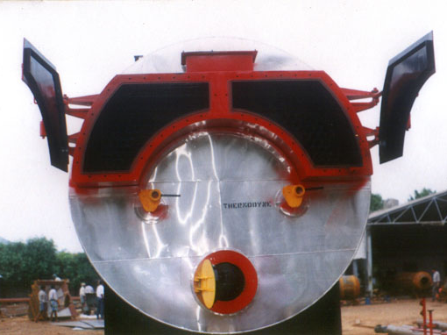
FACTORY
Fire Tube Boiler – Rear Smoke Box
Central Flue

Slide 41
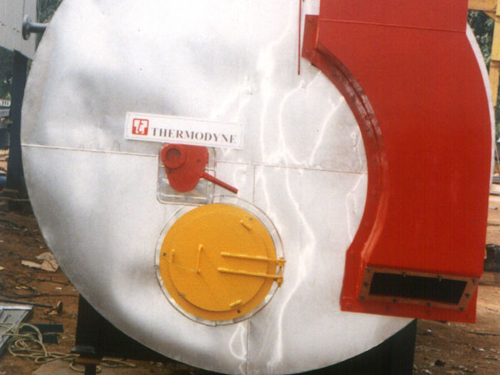
FACTORY
Fire Tube Boiler – Rear Smoke Box
Offset Flue

Slide 42
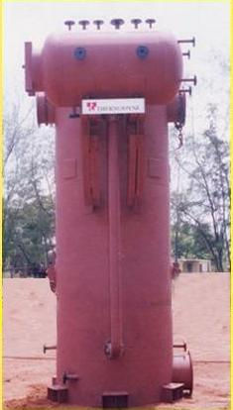
FACTORY
  Waste heat boiler - D.G. Exhaust

Slide 43
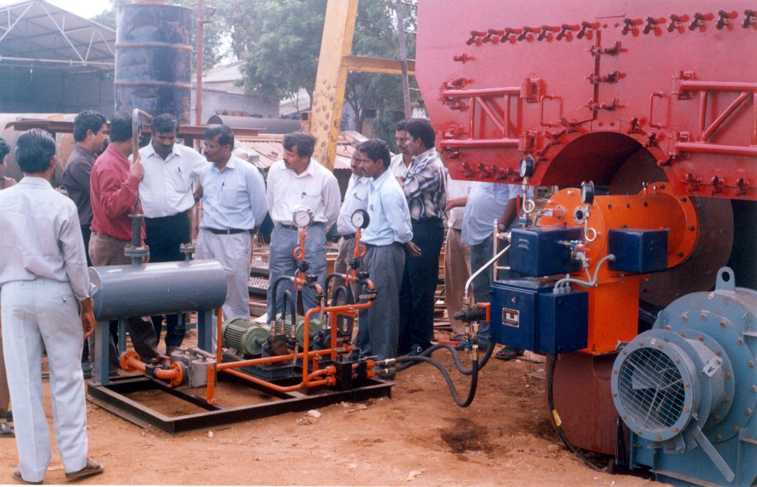
FACTORY
Fire testing of Packaged Fire Tube Boiler

Slide 44
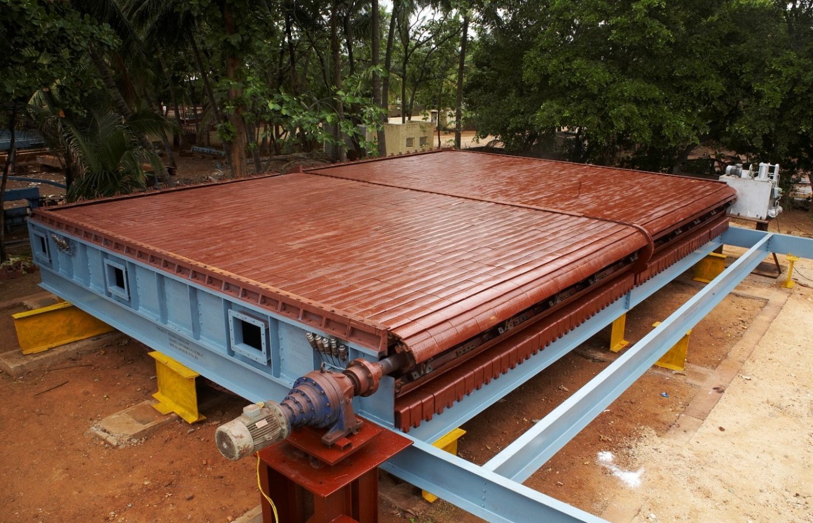
Combustion Equipments
FACTORY
Travelling Grate
Shop Trial Run

Slide 45
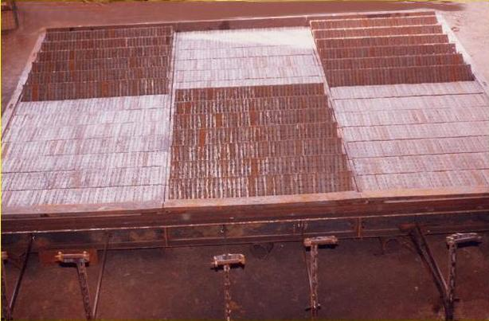
Combustion Equipments
FACTORY
Dump Grate
3 Streams – 6 Sections
3 Opened – 3 Closed

Slide 46
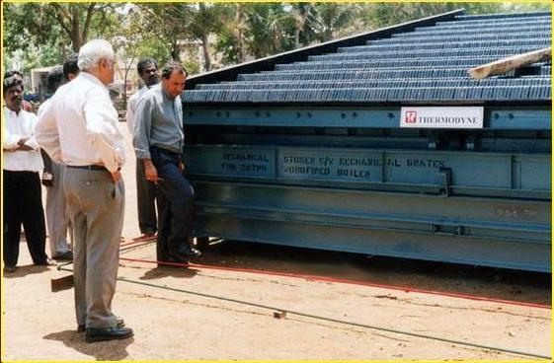
Combustion Equipments
FACTORY
Reciprocating Grate
Shop Trial Run

Slide 47
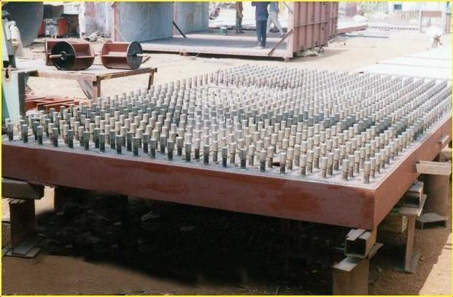
Combustion Equipments
FACTORY
Fluidised Bed Combustor

Slide 48
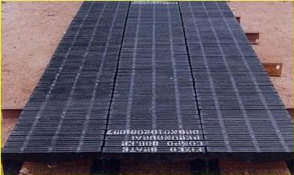
Combustion Equipments
FACTORY
Stationary Grate

Slide 49
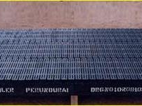
Combustion Equipments
FACTORY
Stationary Grate

Slide 50
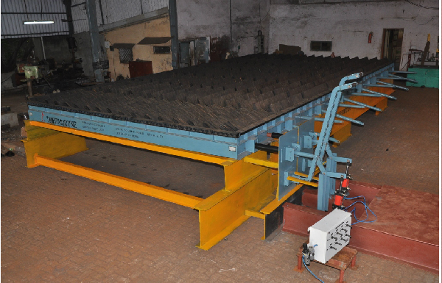
Combustion Equipments
FACTORY
Dumping Grate

Slide 51
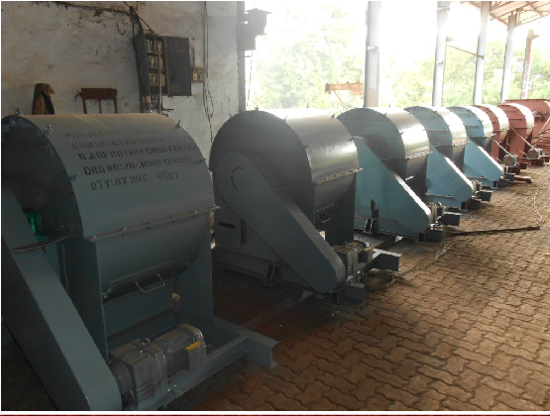
Combustion Equipments
FACTORY
Drum Fuel Feeders

Slide 52
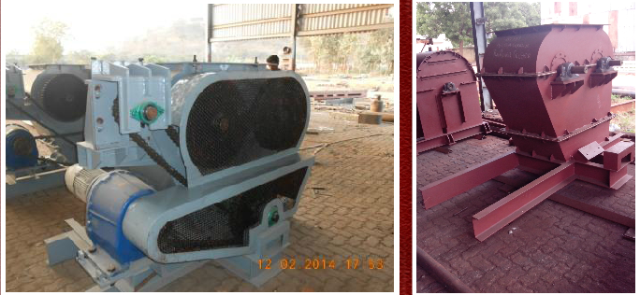
Combustion Equipments
FACTORY
Two Roller Feeders

Slide 53
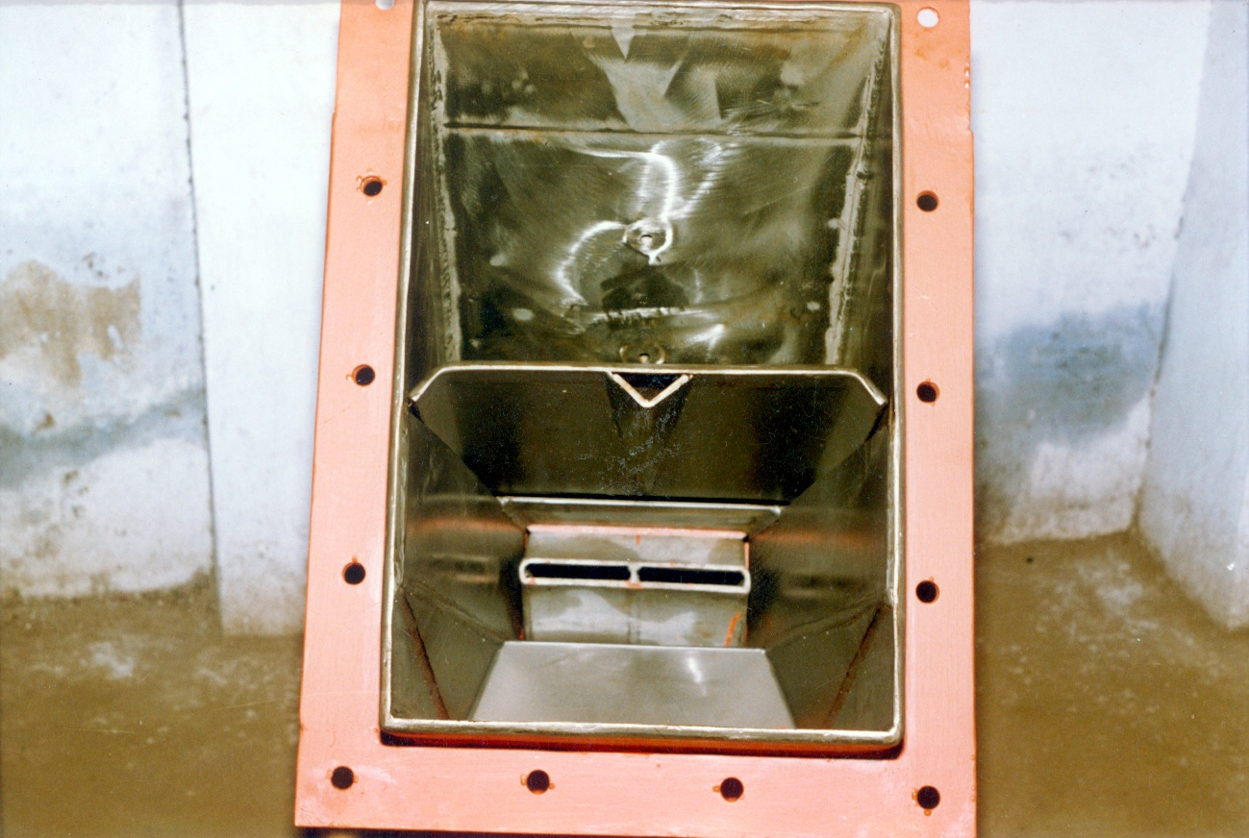
Combustion Equipments
FACTORY
Pneumatic Spreader

Slide 54
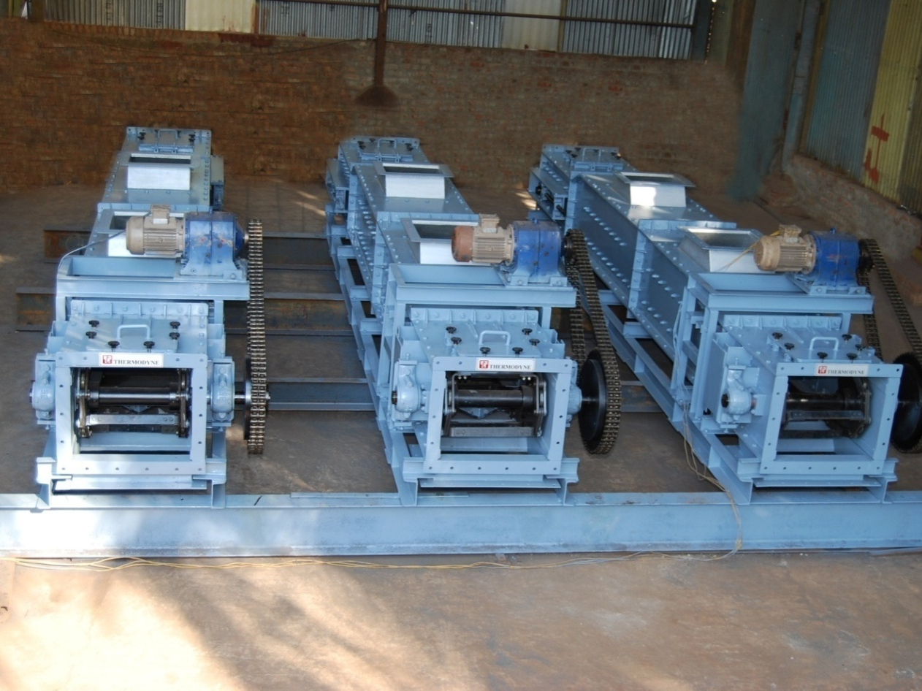
Combustion Equipments
FACTORY
Drag Link Feeders

Slide 55
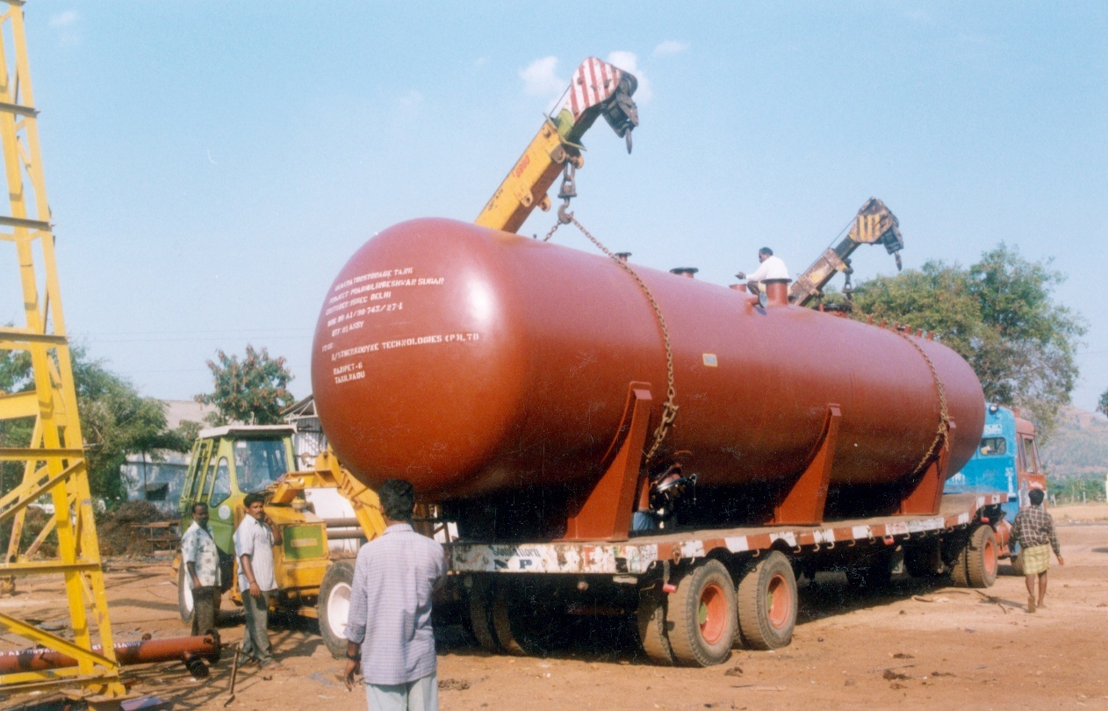
FACTORY
Deaeroator Storage Tank
Predespatch

Slide 56
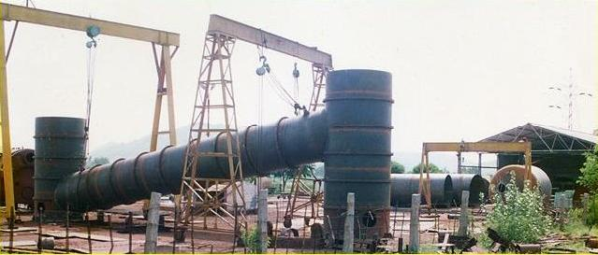
FACTORY
Process Vessel
Shop Trial Assembly

Slide 57
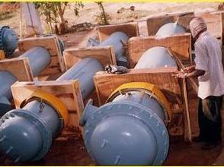
FACTORY
Heat Exchangers
Predespatch

Slide 58
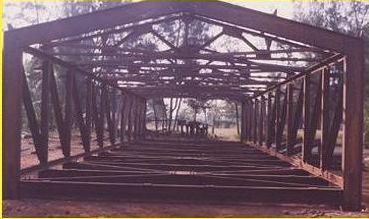
FACTORY
Material Handling Structures
Shop Trial Assembly

Slide 59
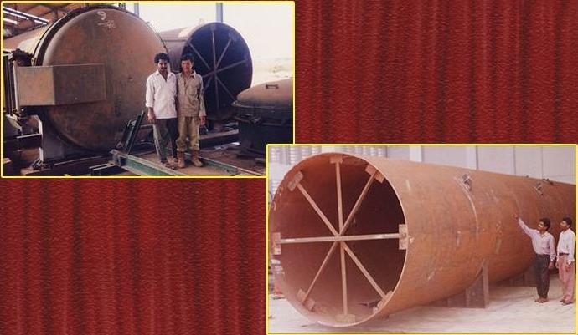
FACTORY
Process Vessel - Steriliser

Slide 60
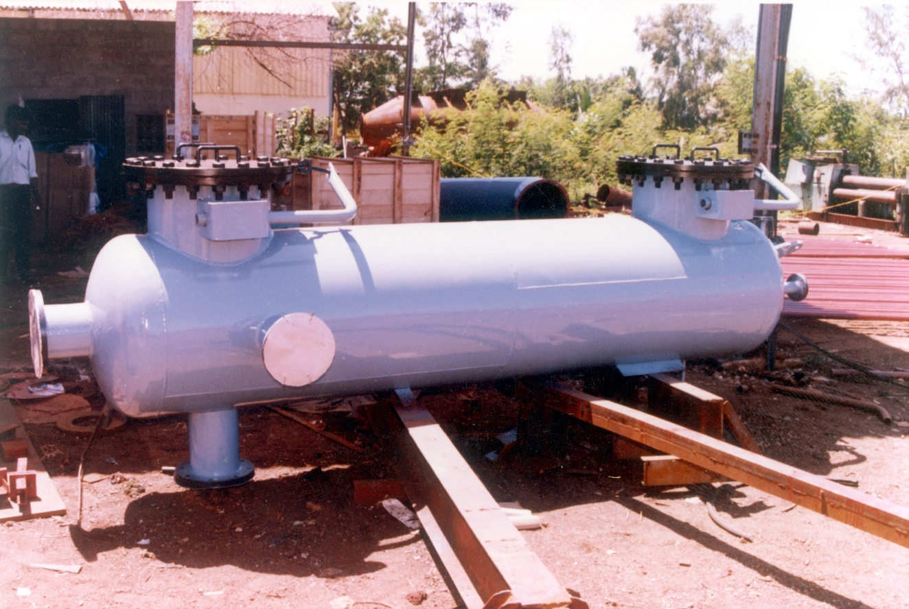
FACTORY
Deaeroator - Predespatch

Slide 61
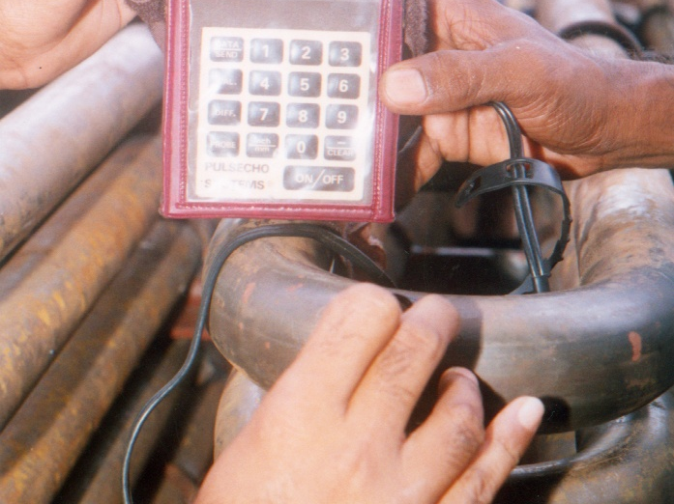
FACTORY
Ultrasonic Testing - Coil Bends
Thinning Check

Slide 62
JOB PROFILE
TECHNOLOGY EXPORT
WATER TUBE BOILERS
PACKAGE / COMPO BOILERS
REVAMP / UPGRADATION
PROCESS EQUIPMENT / COMPONENTS
PRODUCT EXPORT

Slide 63
JOB PROFILE- EXPORT
 | Specifications | Technology Recipients
Performance and Detailed Design Engineering | 20 TPH to 60 TPH Palm fibre Fired Water Tube Boiler | Petra Boilers, Malaysia Advance Boilers, Malaysia
Performance and Detailed Design Engineering | Oil and Gas Fired Packaged Boiler | English Boiler & Tube, Virginia, USA
* Heavy Engineering shop-Facilities & Layout Project Review | 15000 Tons Per Annum production capacity | P.T.Perkasa Heavyndo Engg, Indonesia
TECHNOLOGY EXPORT

Slide 64
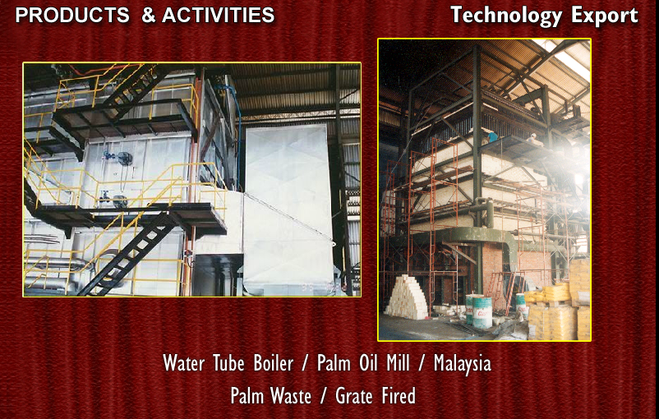

Slide 65
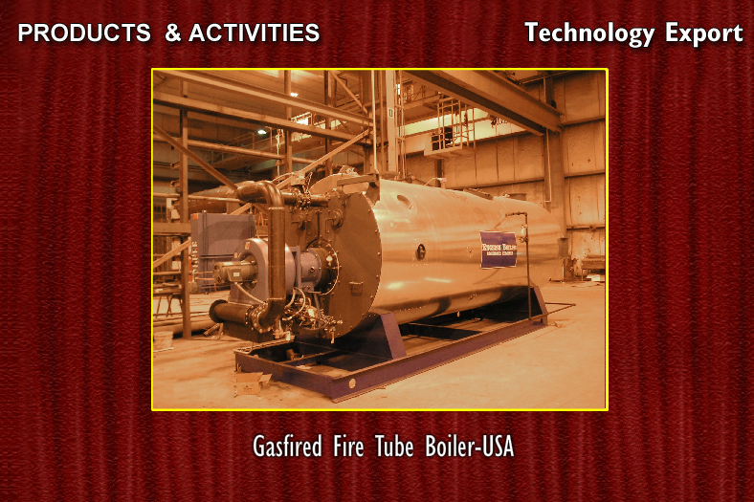

Slide 66
JOB PROFILE- EXPORT
Specifications | CUSTOMER / END USER
45 TPH Oil Fired Fire Tube Boiler | Magadi Soda Ash – Kenya AST Beverages – Bangladesh Persus – Myanmar Sembawang – Singapore
2 Nos. 30 TPH Waste Heat Boilers | Meridien Utilities – Malaysia
25 TPH / Biomass | Sabut Mas Abadi – Indonesia
15 TPH / Bagasse | Songlam Sugars - Vietnam
35 TPH / Bagasse | Sugar Corporation - Uganda
45 TPH / Coal | PT DUS – Indonesia
20 TPH / Biomass | Euroasian Ventures - Nigeria
2 Million Kcal/hr Waste Heat Boiler | Callidus by Honeywell Staatsolie – Suriname
TECHNOLOGY EXPORT

Slide 67
JOB PROFILE- EXPORT
Specifications | CUSTOMER / END USER
60 TPH / Palm Waste | Numar Group- Costa Rica
45 TPH/ Palm Waste | Numar Group – Costa Rica
35 TPH / Palm Waste | GA Expertise – Caicesa – Honduras
20 TPH / Palm Waste | Numar Group – Nicaragua
80 TPH / Bagasse | Trangkil Sugar – Indonesia
2 x 35 TPH / Biomass | Biogas Energo – Ukraine
PRODUCT EXPORT – BOILER COMPONENTS
Specifications | CUSTOMER / END USER
Combustion Equipment (Grate) | Advance Boilers – Malaysia
Tubular Pressure Parts | Boiler Care – Malaysia
Economisers | Boiler & Burners – Malaysia
55 TPH Boiler Revamp | Metahara Sugars – Ethiopia
20 TPH Boiler Revamp | Zanzibar Sugars – Tanzania
PRODUCT EXPORT

Slide 68
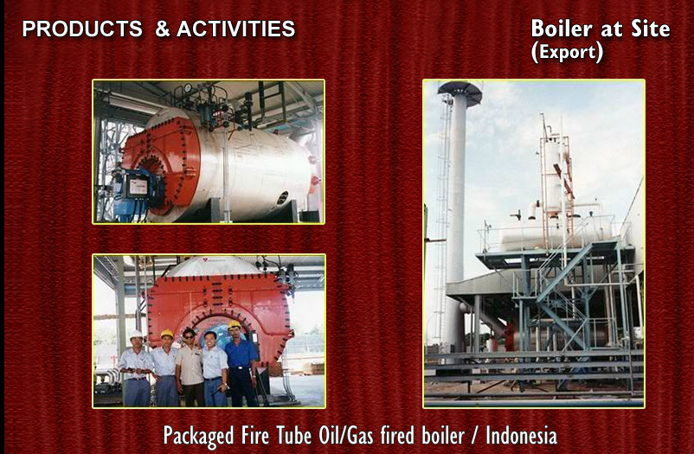

Slide 69
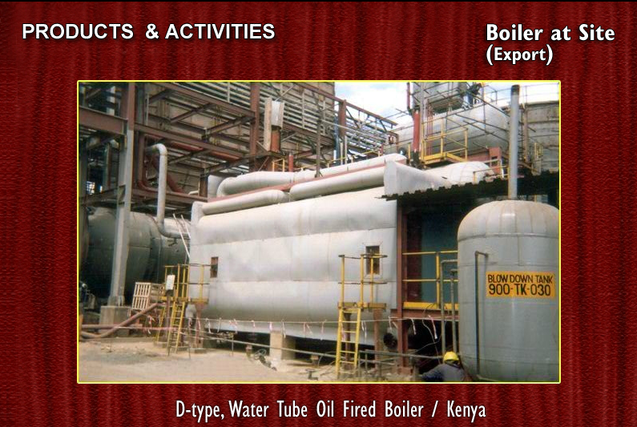

Slide 70
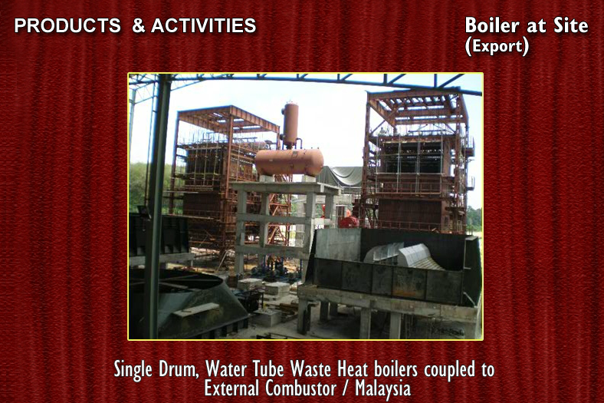

Slide 71
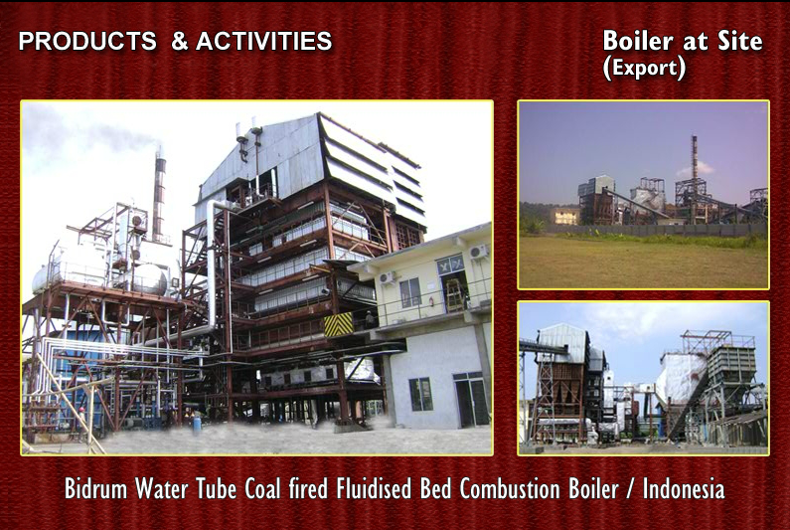

Slide 72
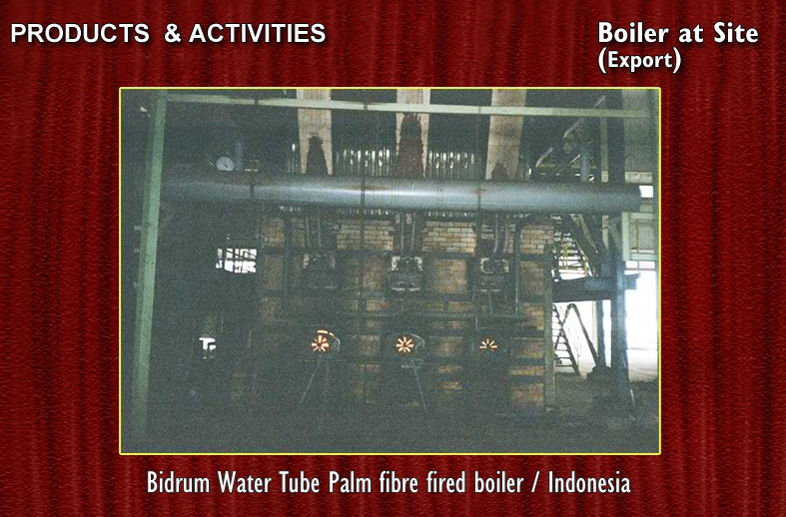

Slide 73
JOB PROFILE – INDIA
WATER TUBE BOILERS – 5 TPH TO 140 TPH / 21 BAR TO 87 BAR
CUSTOMER / END USER | STATE | CUSTOMER / END USER | STATE
Palmtech, Suchand Powergen, Velagapudi Power, Venkataraya Fibres, Rayalaseema Green Energy, PSR Green Power, Shravana Power, Shasta Bio, SNS Starch, SPY Agro, Redan Infrastructure, Ruchi Soya | Andhra Pradesh | Nirani Sugars, ICL Sugars, Badami Sugars, JP Dist., SLN Dist., Renuka Sugars, Hothur Steel, Sree Guruprabha Power, Hothur Ispat, Srinivasa Gayithri ResourceEnergy, Matrix Agro | Karnataka
Suman Agritech | Bihar | Universal Starch, Kay Pulp & Paper, Vayunandana Power, Renuka Sugars, Sunil Hitech, BS Ispat | Maharashtra
Navdurga, Rukmani Power | Chattisgarh | Godrej Agrovet | Mizoram
Gulshan Polyols, Gokulanand Petro, Santosh Starch, Gandevi Sugars, Abellon CleanEnergy, Pidilite | Gujarat | Deepak Steel & Power | Orissa
Rana Sugars, Nahar Sugars, Nahar Fabrics, Narindera Paper | Punjab | Mahalakshmi Sugars, Simbhaoli Sugars, Chilwaria Sugars, GulshanSugar & Chemicals, Kailash Papers, Sumati Sugars, Yadu Sugars | Uttar Pradesh
Gulshan Chemicals, Sharda Solvents, Transtech Green Power | Rajasthan | Jaibalaji Industries, Indian Oil Corporation | West Bengal
Chitra Bio Energy, Prathyusha Power, Kamachi Steel & Power, Tamilnadu, Chemical Products, Synergy Shakti, Rajkumar Impex, Sennar Papers, Ohm Srinivasa, Cetex Petrochemicals | Tamilnadu
WATER TUBE BOILERS

Slide 74
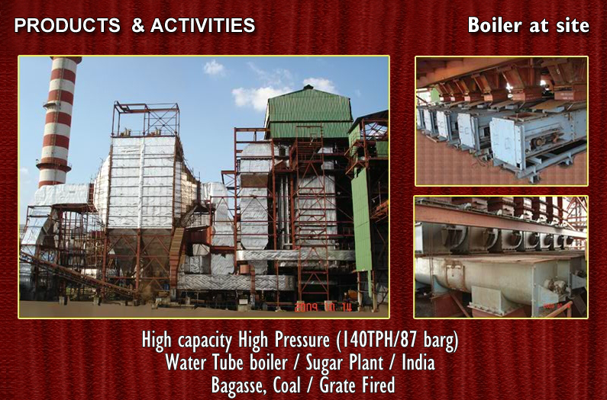

Slide 75
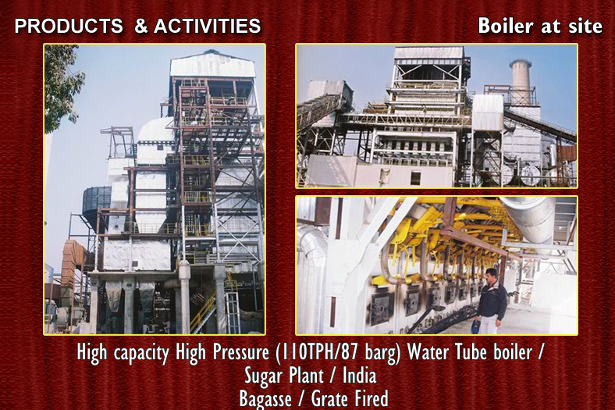

Slide 76


Slide 77


Slide 78


Slide 79


Slide 80


Slide 81


Slide 82


Slide 83
JOB PROFILE – INDIA
PACKAGE BOILERS / COMPO BOILERS
SPECIFICATIONS | SELECTED CUSTOMERS
OIL / WOOD / COAL / HUSK
5 TPH / 35 ATG / OIL | Department of Atomic Energy
6 TPH / 10.5 ATG / OIL | Indian Oil Corporation
6 TPH / 17.5 ATG / OIL | Ramco Industries
12 TPH / 12 ATG / FBC | Santosh Starch
6 TPH / 21 ATH / BIOMASS | Classic Polo
0.5 TPH to 8 TPH 10.5 ATH / SOLID FUEL | Textile Process Industries
PACKAGE / COMPO BOILERS

Slide 84


Slide 85


Slide 86
JOB PROFILE – INDIA
REVAMP / UPGRADATION
SPECIFICATIONS | CUSTOMERS | SPECIFICATIONS | CUSTOMERS
* Efficiency / Capacity Improvement |  | * Coal Firing Retrofit / Fuel Conversion
2 x 18 TPH | Mahalakshmi Sugars, UP | 1 x 140 TPH | Shree Renuka Sugars, Karnataka
1 x 35 TPH | Nahar Sugars, Punjab | 1 x 75 TPH | Simbhaoli Sugars, Uttar Pradesh
2 x 32 TPH | Oswal Sugars, Punjab | 1 x 100 TPH | Shree Renuka Sugars, Karnataka
1 x 50 TPH | Simbhaoli Sugars, UP | 1 x 100 TPH | Shree Renuka Sugars, Karnataka
1 x 40 TPH | Rana Sugars, UP | 1 x 120 TPH | AB Sugars, Punjab
1 x 20 TPH | Gandevi Sugars, Gujarat | 1 x 40 TPH | Nahar Sugars, Punjab
1 x 50 TPH | Genus Papers, UP | 1 x 77 TPH | Uniworld, Gujarat
1 x 20 TPH | Sree Rayalaseema, AP | 1 x 80 TPH | Simbhaoli Power, Uttar Pradesh
REVAMP / UPGRADATION

Slide 87
JOB PROFILE – INDIA
PROCESS EQUIPMENT / BOILER COMPONENTS
 | SPECIFICATIONS | SELECTED CUSTOMERS
Power Boiler Components | HP/LP Steam Piping ESP/Fan/APH Components Flat Fin Economiser | BHEL
Heat Exchangers | Customised specs | MRF / TCL / Snowcem / EID Parry
Pressure Vessels | Sterilisers / Steam Accumulator | Palmtech India
Industrial Boiler Components | Economiser / Superheater Ductings / Structure | ISGEC TASCO & Others
PROCESS EQUIPMENT / COMPONENTS

